Slide 1
RESUME SUITABILITY SCREENER
Developed using Python, Streamlit, Machine Learning

Slide 2
PROJECT CONTRIBUTORS
Divyanka Barnwal BCA, 3rd Year
Senha Ghosh BCA, 3rd Year
Shreyashi Chatterjee BCA, 3rd Year

Slide 3
INTRODUCTION
The Resume Suitability Screener is a Machine Learning-based tool designed to simplify and automate the initial resume evaluation process.
By leveraging algorithms like Random Forest and K-Nearest Neighbors (KNN), the system can quickly assess how well each resume matches a selected job role, providing a suitability score for every candidate.
It can handle multiple resumes simultaneously, making it practical for real-world recruitment scenarios. The results are presented in clear visualizations such as donut charts, allowing recruiters to easily compare candidates at a glance.
This system aims to save time, ensure fairness, and improve efficiency in the recruitment process, enabling recruiters to focus on selecting the best talent rather than manually screening resumes.

Slide 4
PROJECT SCOPE
Automates resume screening
The system replaces manual resume evaluation with an AI-driven approach, making the shortlisting process faster and less error-prone.
Analyzes resumes against specific job roles
Recruiters can choose a target job role, and the system evaluates how well each uploaded resume matches that role.
Supports bulk processing
The tool can handle multiple resumes simultaneously (up to 5 at a time), making it suitable for real hiring scenarios.
Generates suitability scores
Each resume is assigned a percentage score that reflects its relevance to the selected job role.
Provides clear visualization
Results are shown in a donut chart, enabling easy comparison between candidates at a glance.
Improves efficiency and fairness
Saves recruiters’ time and effort, while ensuring a consistent, unbiased, and data-driven shortlisting process.

Slide 5
PROJECT PURPOSE
Make recruitment faster
Minimize time spent on manual resume screening.
Ensure accurate shortlisting
Match candidate skills with job requirements precisely.
Rank candidates efficiently
Highlight top candidates for easier decision-making.
Promote fairness
Provide unbiased, data-driven evaluations.
Support recruiters
Help HR focus on interviews rather than initial screening.
1
2
3
4
5

Slide 6
WORKING OF ML IN THE PROJECT
Resume Upload & Preprocessing
Resumes are uploaded in PDF/DOC format.
Text is extracted, cleaned (stopwords removed, tokenization applied).
Feature Extraction
Convert resume text into numerical vectors using TF-IDF. Important skills/keywords are highlighted.
Model Training
Past labeled resumes (job role → suitable/unsuitable) are used.
Algorithms used: Random Forest and KNN.
Prediction & Scoring
For each uploaded resume, the trained model predicts suitability.
A score (%) is assigned showing how well the resume matches the selected job role.
Visualization
Scores are shown in a donut chart for quick comparison between candidates.

Slide 7
ALGORITHMS USED IN PROJECT
Resume Text
Random Forest
Key Principle
Combines multiple decision trees (majority voting).
Why Used in Project?
Improves accuracy, reduces overfitting, handles noisy resume data.
TF-IDF Vector
K-Nearest Neighbors (KNN)
Random Forest (Decision Trees)
KNN (Nearest Neighbors)
Key Principle
Classifies based on similarity to nearest data points.
Why Used in Project?
Simple, effective after TF-IDF, good for detecting skill patterns.
Suitability Score
Summary
Random Forest = stability & accuracy
KNN = similarity & local pattern detection
Together = balanced, reliable resume screening
Donut Chart

Slide 8
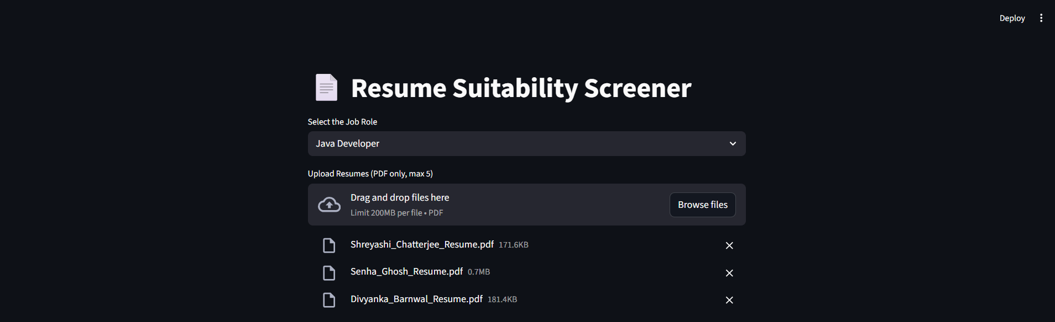
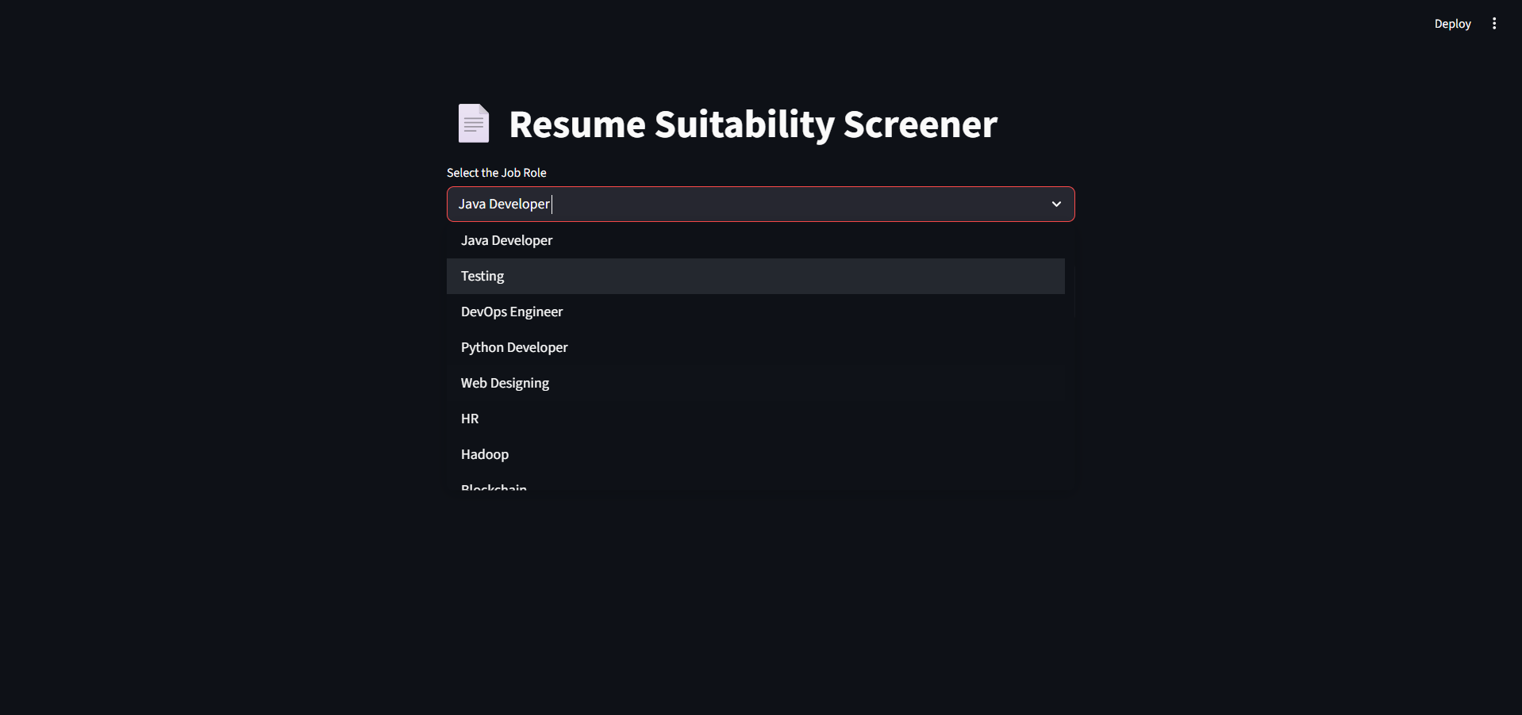
SCREENSHOTS OF THE PROJECT 1
Screenshot 1: Selection of Job Role from Dropdown Box
Screenshot 2: Uploading Resumes for Evaluation

Slide 9
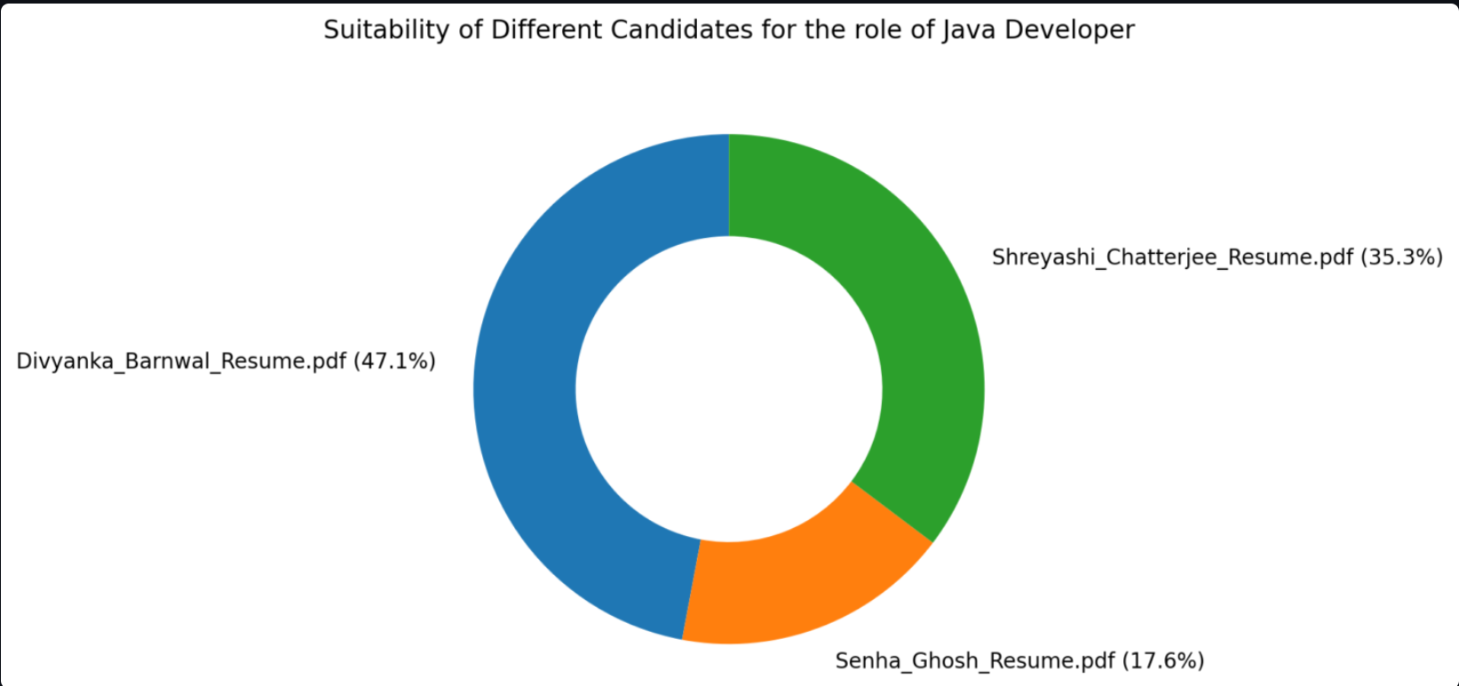
SCREENSHOTS OF THE PROJECT 2
Screenshot 3: Donut Graph Showing Comparison
Screenshot 1: Selection of Job Role from Dropdown Box :
Shows the recruiter choosing the target job role.
Screenshot 2: Uploading Resumes for Evaluation :
Demonstrates uploading multiple resumes (PDFs) for analysis.
Screenshot 3: Donut Graph Showing Comparison :
Visualizes the suitability scores for all uploaded resumes in percentages.
Makes it easy to compare candidates at a glance.

Slide 10
FUTURE SCOPE OF THE PROJECT
Expand Algorithms
Explore deep learning models (BERT, CNNs, RNNs) for better context understanding beyond Random Forest & KNN.
Improve Feature Extraction
Move from simple text cleaning + TF-IDF to word embeddings (Word2Vec, GloVe, Sentence Transformers) for richer representation.
Hyperparameter Optimization
Use Grid Search / AutoML to fine-tune Random Forest and KNN for higher accuracy.
Scalability
Handle large volumes of resumes efficiently with distributed processing.
Real-Time Processing
Allow recruiters to upload resumes and get instant screening feedback.
Integration
Connect with LinkedIn / Job Portals / ATS systems for end-to-end recruitment workflow.
Explainability
Add model interpretability (feature importance, SHAP values) so recruiters understand why a resume got a certain score.

Slide 11
CONCLUSION
The system automates resume screening, reducing manual effort for recruiters.
Uses ML algorithms (Random Forest & KNN) for accurate candidate suitability scoring.
Handles multiple resumes at once and provides visual comparison via donut charts.
Ensures fairness, consistency, and data-driven shortlisting.
Scalable for future improvements like advanced NLP models, multi-language support, and ATS integration.
In a nutshell:
“A smart system that empowers recruiters to make quick and impartial hiring decisions.”

Slide 12
Thank You :)

